Slide 1

Maker Space
Kyler Kershaw
Marcus Mitchell
Daniel Bigler
Jessica Prater

Slide 2
Who we are
Kyler
Marcus
Daniel
Jessica

Slide 3
What does the application do?
Monitor currently scheduled bookings
Login/Create new user accounts
Monitor updates on site progress
Admin access.

Slide 4
Front End
Responsible for designing a making the website look presentable
Having login forms and making it available for customers to sign up and make accounts

Slide 5
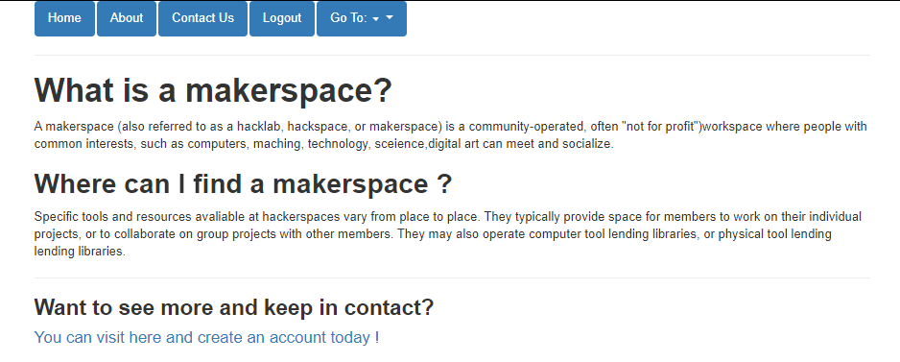
About Maker Space
This page displays a small bit about what a maker space is.

Slide 6
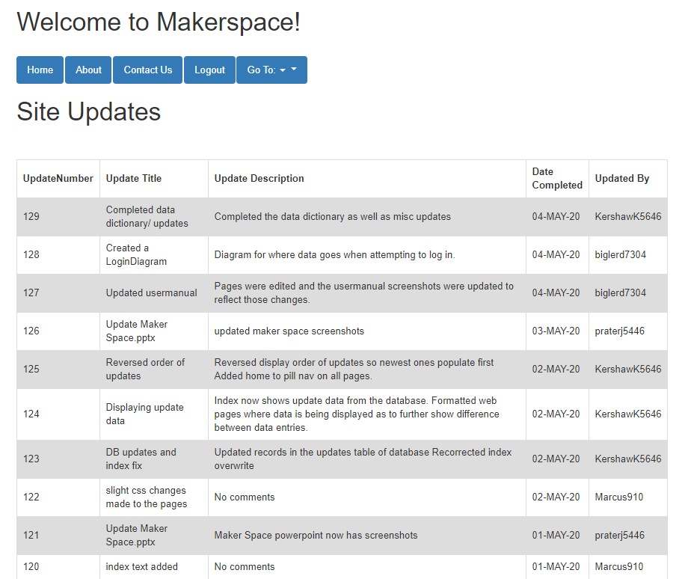
Welcome
The welcome page displays
Login option
Create account option
Site/Project update logs

Slide 7
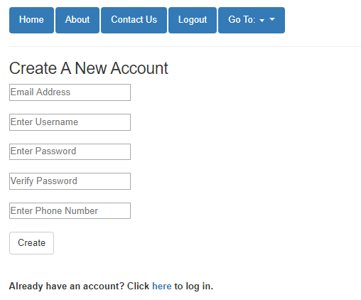
Create Account
Creating an account is a quick and simple process. All that is required are:
Email
Username
Password (as well as password verification)
Phone Number

Slide 8
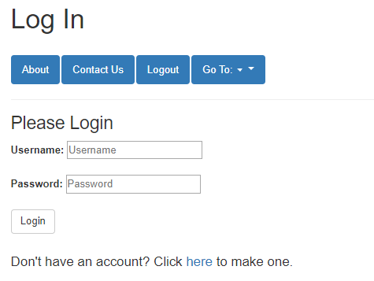
Login
The Login page requires;
Username
Password

Slide 9
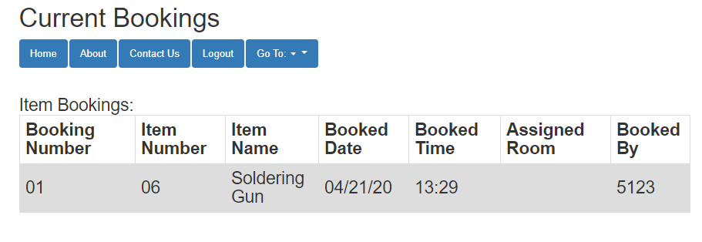
View Room Bookings
Room Booking currently shows rooms that are currently booked.

Slide 10
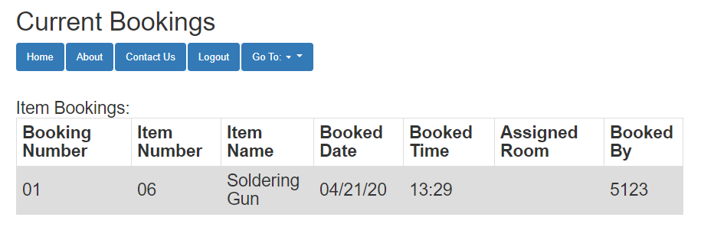
Inventory Bookings
Room Booking currently shows items that are currently booked.

Slide 11
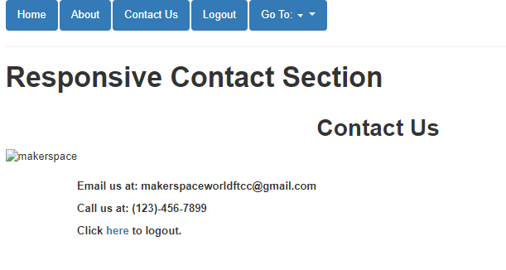
Contact
Contact currently shows contacts of email and phone number to be able to get help or to book a room.

Slide 12
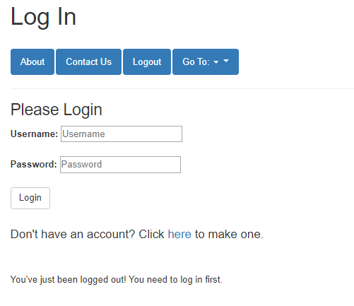
Logout
When you logout, it takes you to the login page and displays a message to show that you have logged out

Slide 13
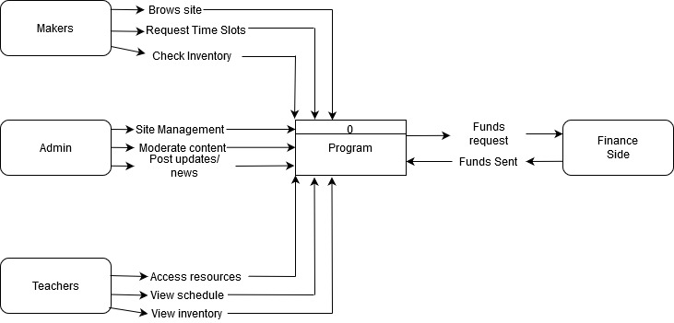
Context diagram

Slide 14
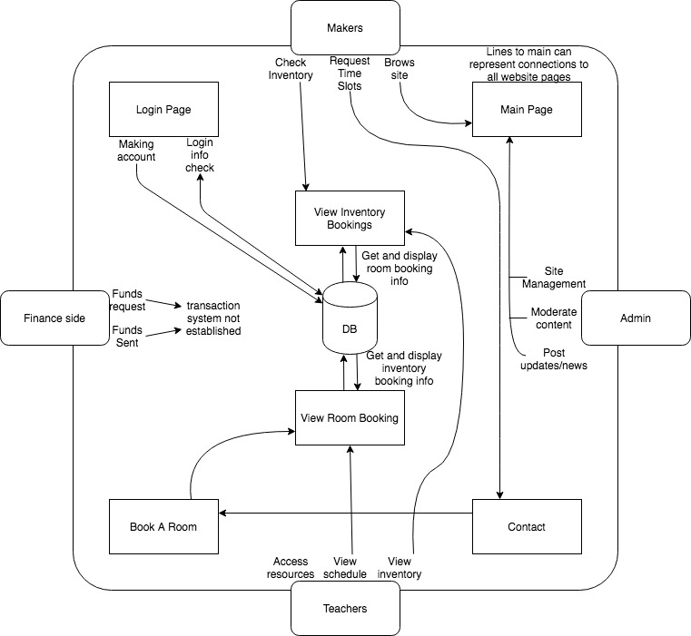
Diagram Zero

Slide 15
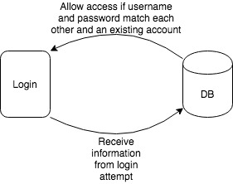
Login Diagram

Slide 16
Q&A
Questions?

